Slide 1
How AI Agents are Changing Construction
Week of March 2th
Elias Hord

Slide 2
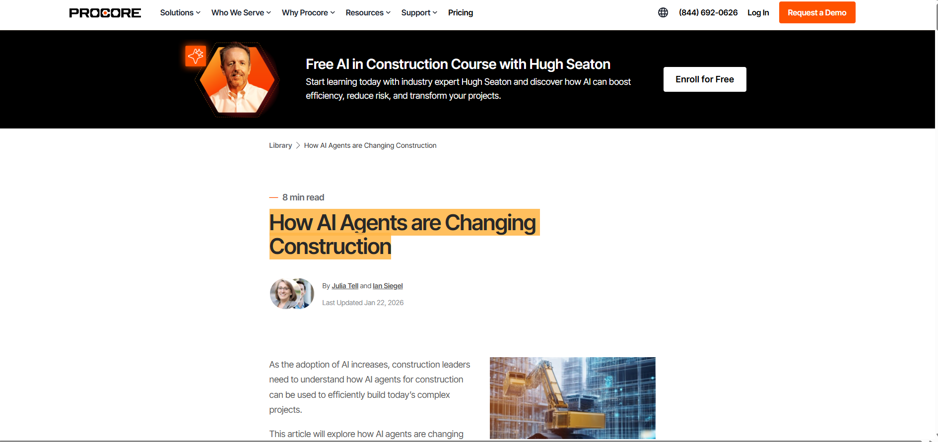
General Information
Article Publication: January 22, 2026
https://www.procore.com/library/ai-agents-construction

Slide 3
Main Findings and Arguments
AI agents are defined as intelligent software systems that can autonomously make decisions and perform actions toward specific goals — going beyond simple chatbot interactions by reasoning, learning, and acting within defined parameters to support construction workflows. In construction contexts, these agents:
Automate routine tasks such as project management, safety monitoring, documentation, scheduling, compliance, and cost oversight.
Function at a more advanced tier of AI than basic large language models or simple assistants, capable of reasoned task execution rather than just answering queries.
Integrate with existing construction technology stacks to bridge data silos and pull insights from multiple sources.
The article emphasizes a variety of agent types — from project management and supply chain agents to safety monitoring and compliance bots — each designed to improve efficiency, accuracy, and decision quality across the lifecycle of a project.
Agents feature predictive analytics, large-scale data collection, computer vision, natural language processing, workflow optimization, and ongoing learning capabilities. These allow them to anticipate problems, streamline reporting, flag risks, and support human decision-makers, ultimately reducing manual labor and errors.

Slide 4
Broader Implications for Society
The rise of AI agents in construction reflects a larger societal shift toward automation and data-driven decision-making:
Work Efficiency and Safety: AI agents can enhance workplace safety by identifying hazards in real time, reducing accidents, and improving compliance monitoring.
Labor and Skill Shifts: As routine construction tasks become automated, there may be shifts in labor demand — potentially easing labor shortages but also requiring new skills from workers. Reduced manual burdens could let professionals focus on higher-value judgment tasks.
Technology Adoption Patterns: Broader adoption of AI agents may accelerate digital transformation in construction, a sector historically slow to embrace new tech, raising questions around training, trust, equity, and workforce readiness.
In society at large, these changes are part of a trend where AI systems augment human capacity in data-intensive fields, reshape job profiles, and prompt governance conversations about ethics, accountability, and transparency.

Slide 5
Relevance or Potential Influence on the Construction Industry
1. Productivity and Cost Improvements: Automating repetitive tasks — such as classifying documents, generating reports, or coordinating schedules — can reduce delays and overruns, helping projects stay on time and budget.
2. Enhanced Decision Support: Agents provide predictive insights and real-time analysis, helping project managers anticipate risks before they materialize and optimize outcomes across planning, execution, and close-out phases.
3. Data Connectivity Across Systems: By pulling data from different software platforms (ERP, project management, document systems), AI agents can help break down silos, creating a more unified project view that improves coordination and reduces rework.
4. New Operational Roles: Agents could shift how teams operate — from superintendents and estimators to compliance officers — by taking on administrative tasks and enabling professionals to focus more on complex problem solving and oversight.
5. Competitive Advantage: Firms that adopt and integrate AI agents effectively may gain strategic advantages through increased efficiency, better risk mitigation, and higher quality deliverables.

